Slide 1
Statistics for Data Analytics
Dr. John S. Butler

Slide 2
Lecturer
John Butler
e-mail: john.s.butler@tudublin.ie

Slide 3
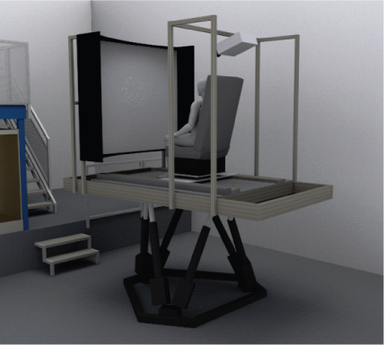

My Background
Numerical Analysis (Trinity College Dublin, PhD work)
Robust Numerical methods of Prandtl Boundary Layer Problems
Self-motion Perception (Max Planck Institute for Biological Cybernetics)
Walking
Driving
Unisensory and Multisensory processing
Developmental Disorders (Albert Einstein College of Medicine)
Autism Spectrum Disorder, Niemann Pick Type C
Movement Disorders (Trinity Centre for Bioengineering)
Parkinson's Disease
Dystonia

Slide 4
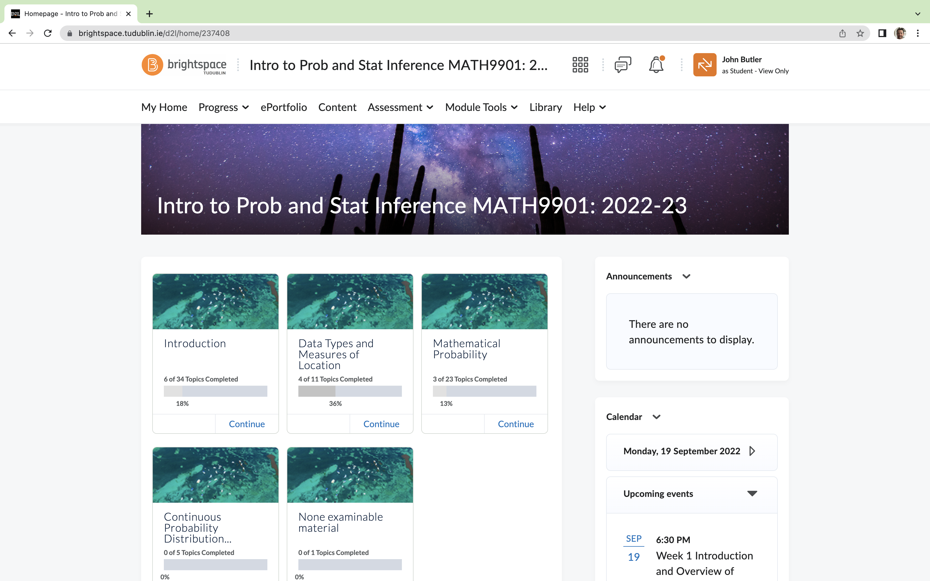
BrightSpace

Slide 5
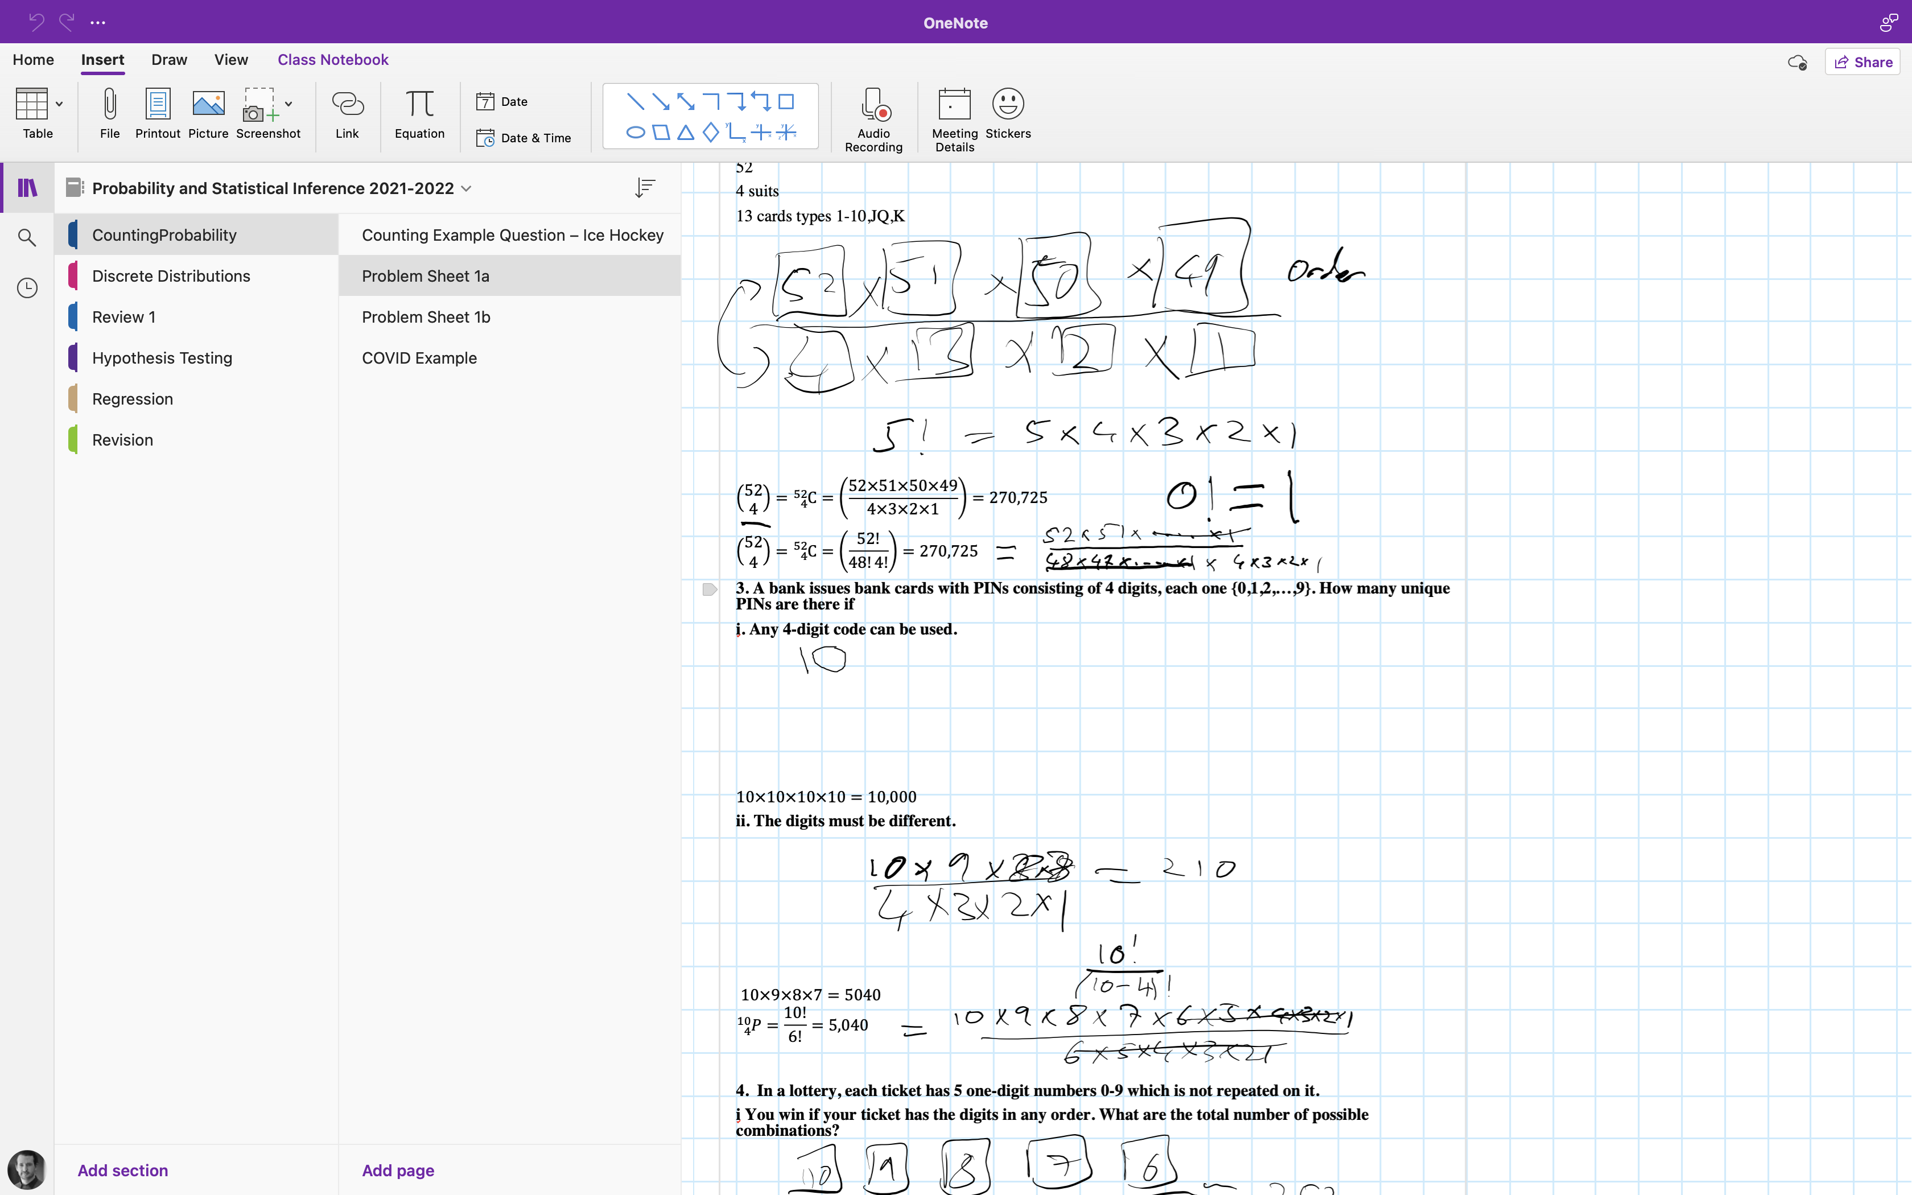
OneNote

Slide 6
The Whole Module in one hours

Slide 7
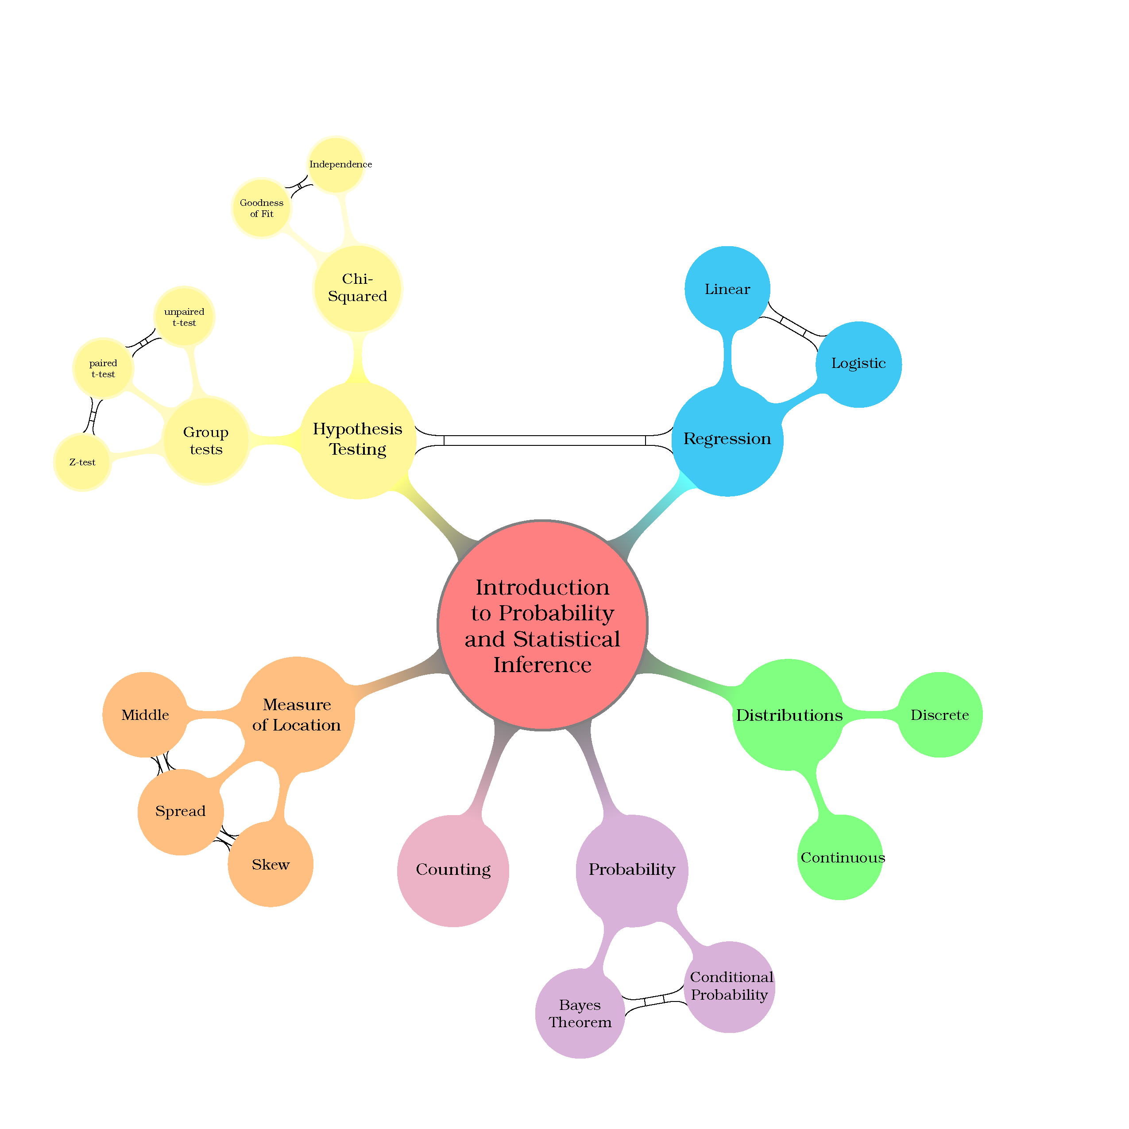

Slide 8
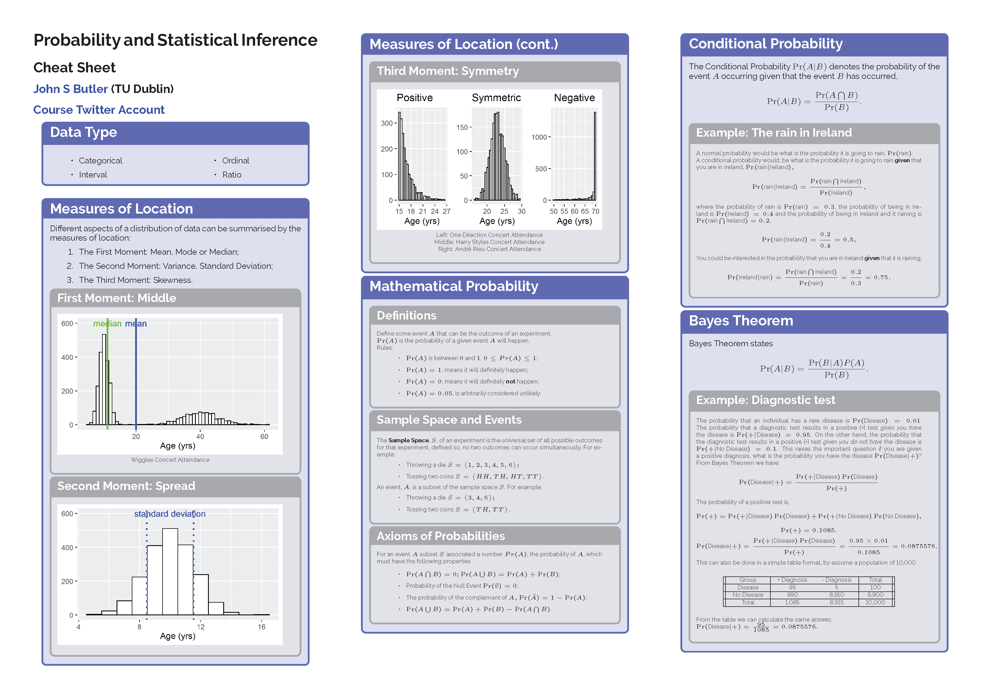

Slide 9

Week 1

Slide 10
Week 1

Slide 11
What Concert is it
The mean age is 23?
Is it a Taylor Swift Concert?
Is it a Wiggles Concert?
Week 1

Slide 12
Mean (average) and Median
Taylor Swift Concert

Slide 13
Spread
Week 1

Slide 14
Skewness
Week 1

Slide 15
The Wiggles Break everything
Wiggles Concert

Slide 17
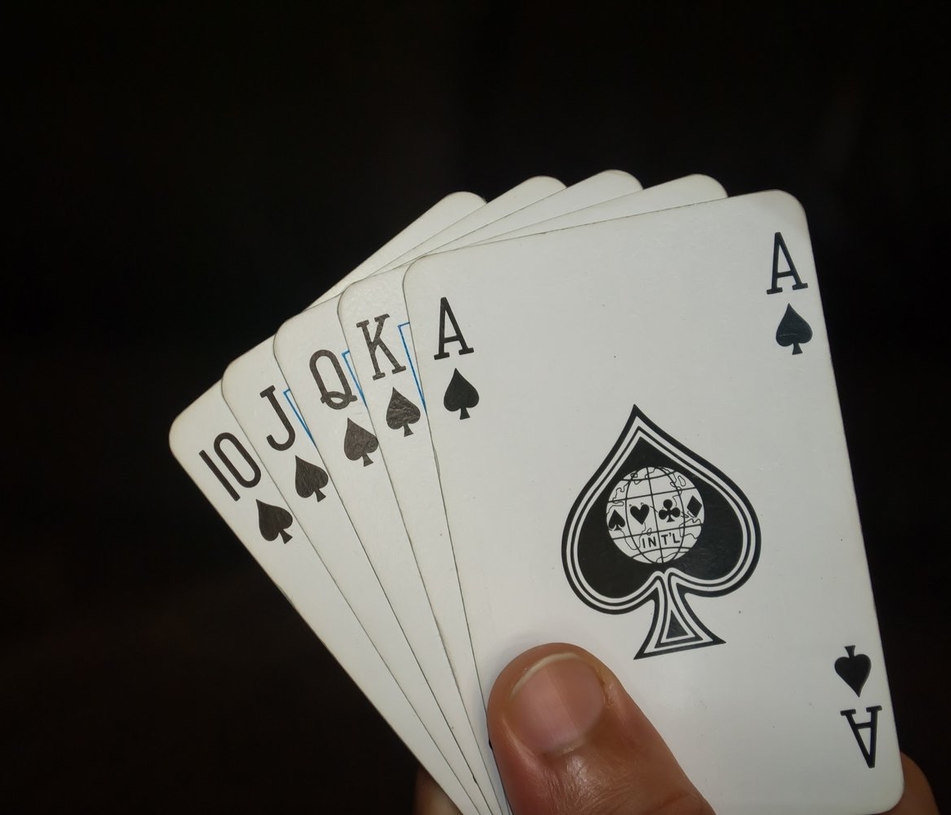
Counting
Number of Royal Flushes
Probability of a Royal Flush

Slide 19
Week 2

Slide 20
Week 2

Slide 21
Week 2-3

Slide 24
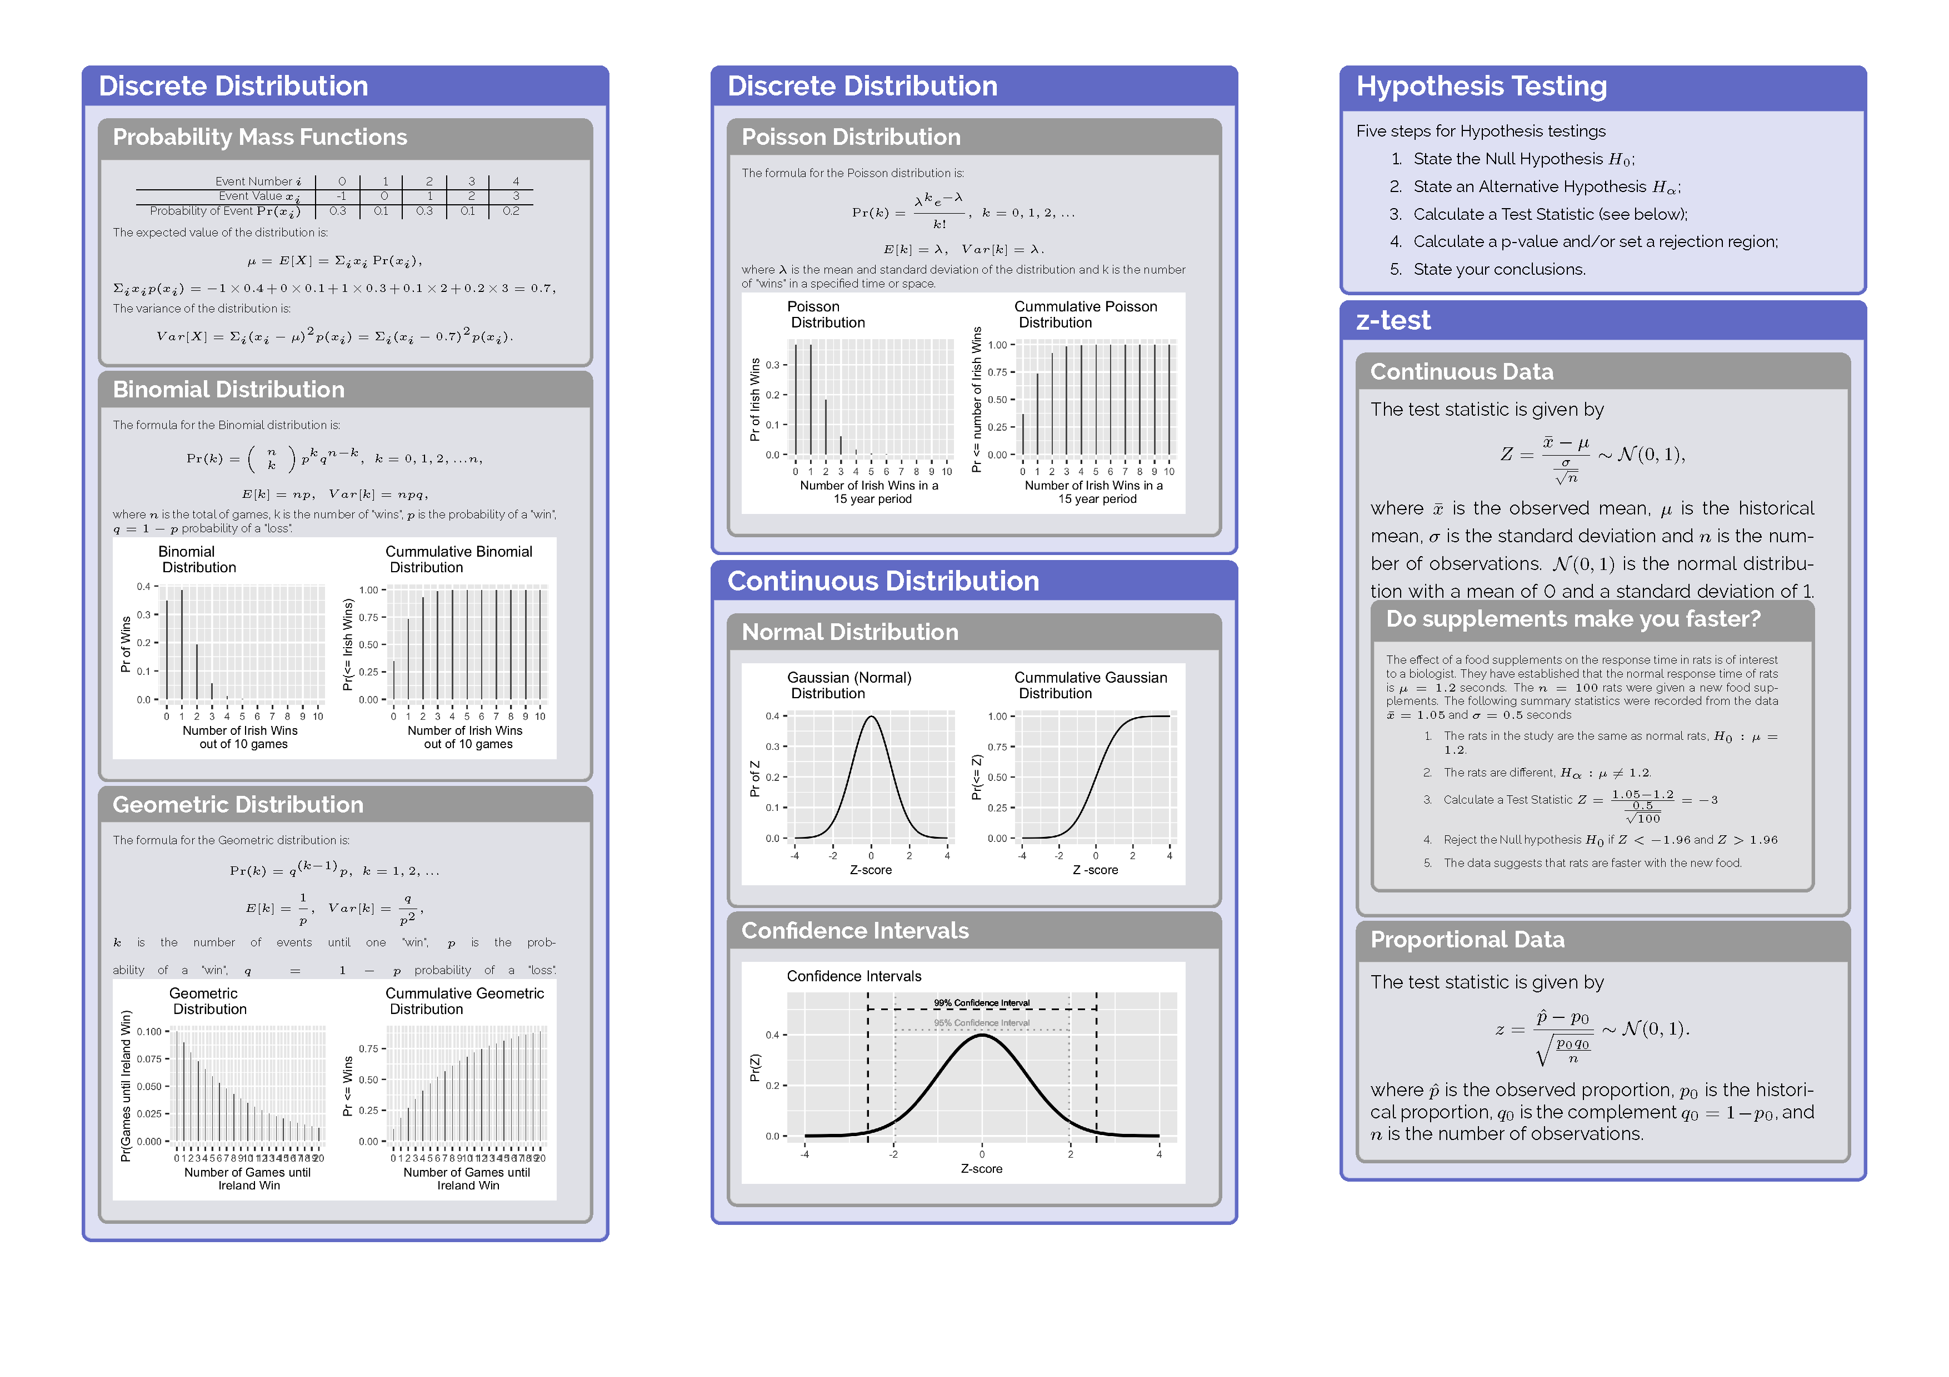

Slide 25

Week 3

Slide 26
Week 3

Slide 28
Week 3-4

Slide 30
Week 4-5

Slide 32
Week 6-8

Slide 33
Week 6-7

Slide 35
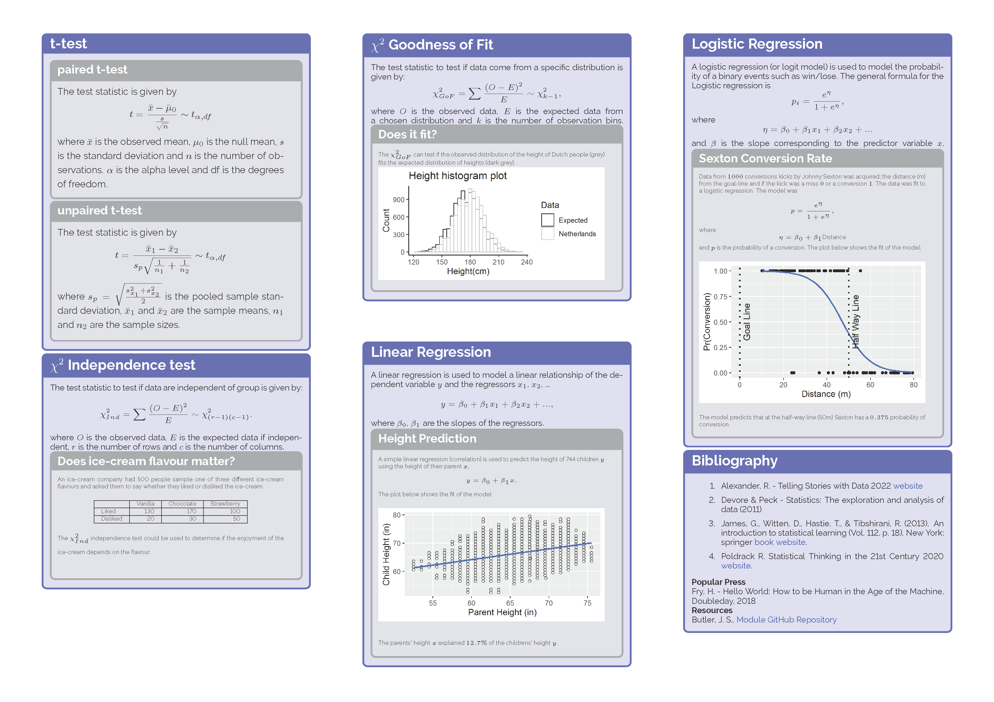

Slide 36
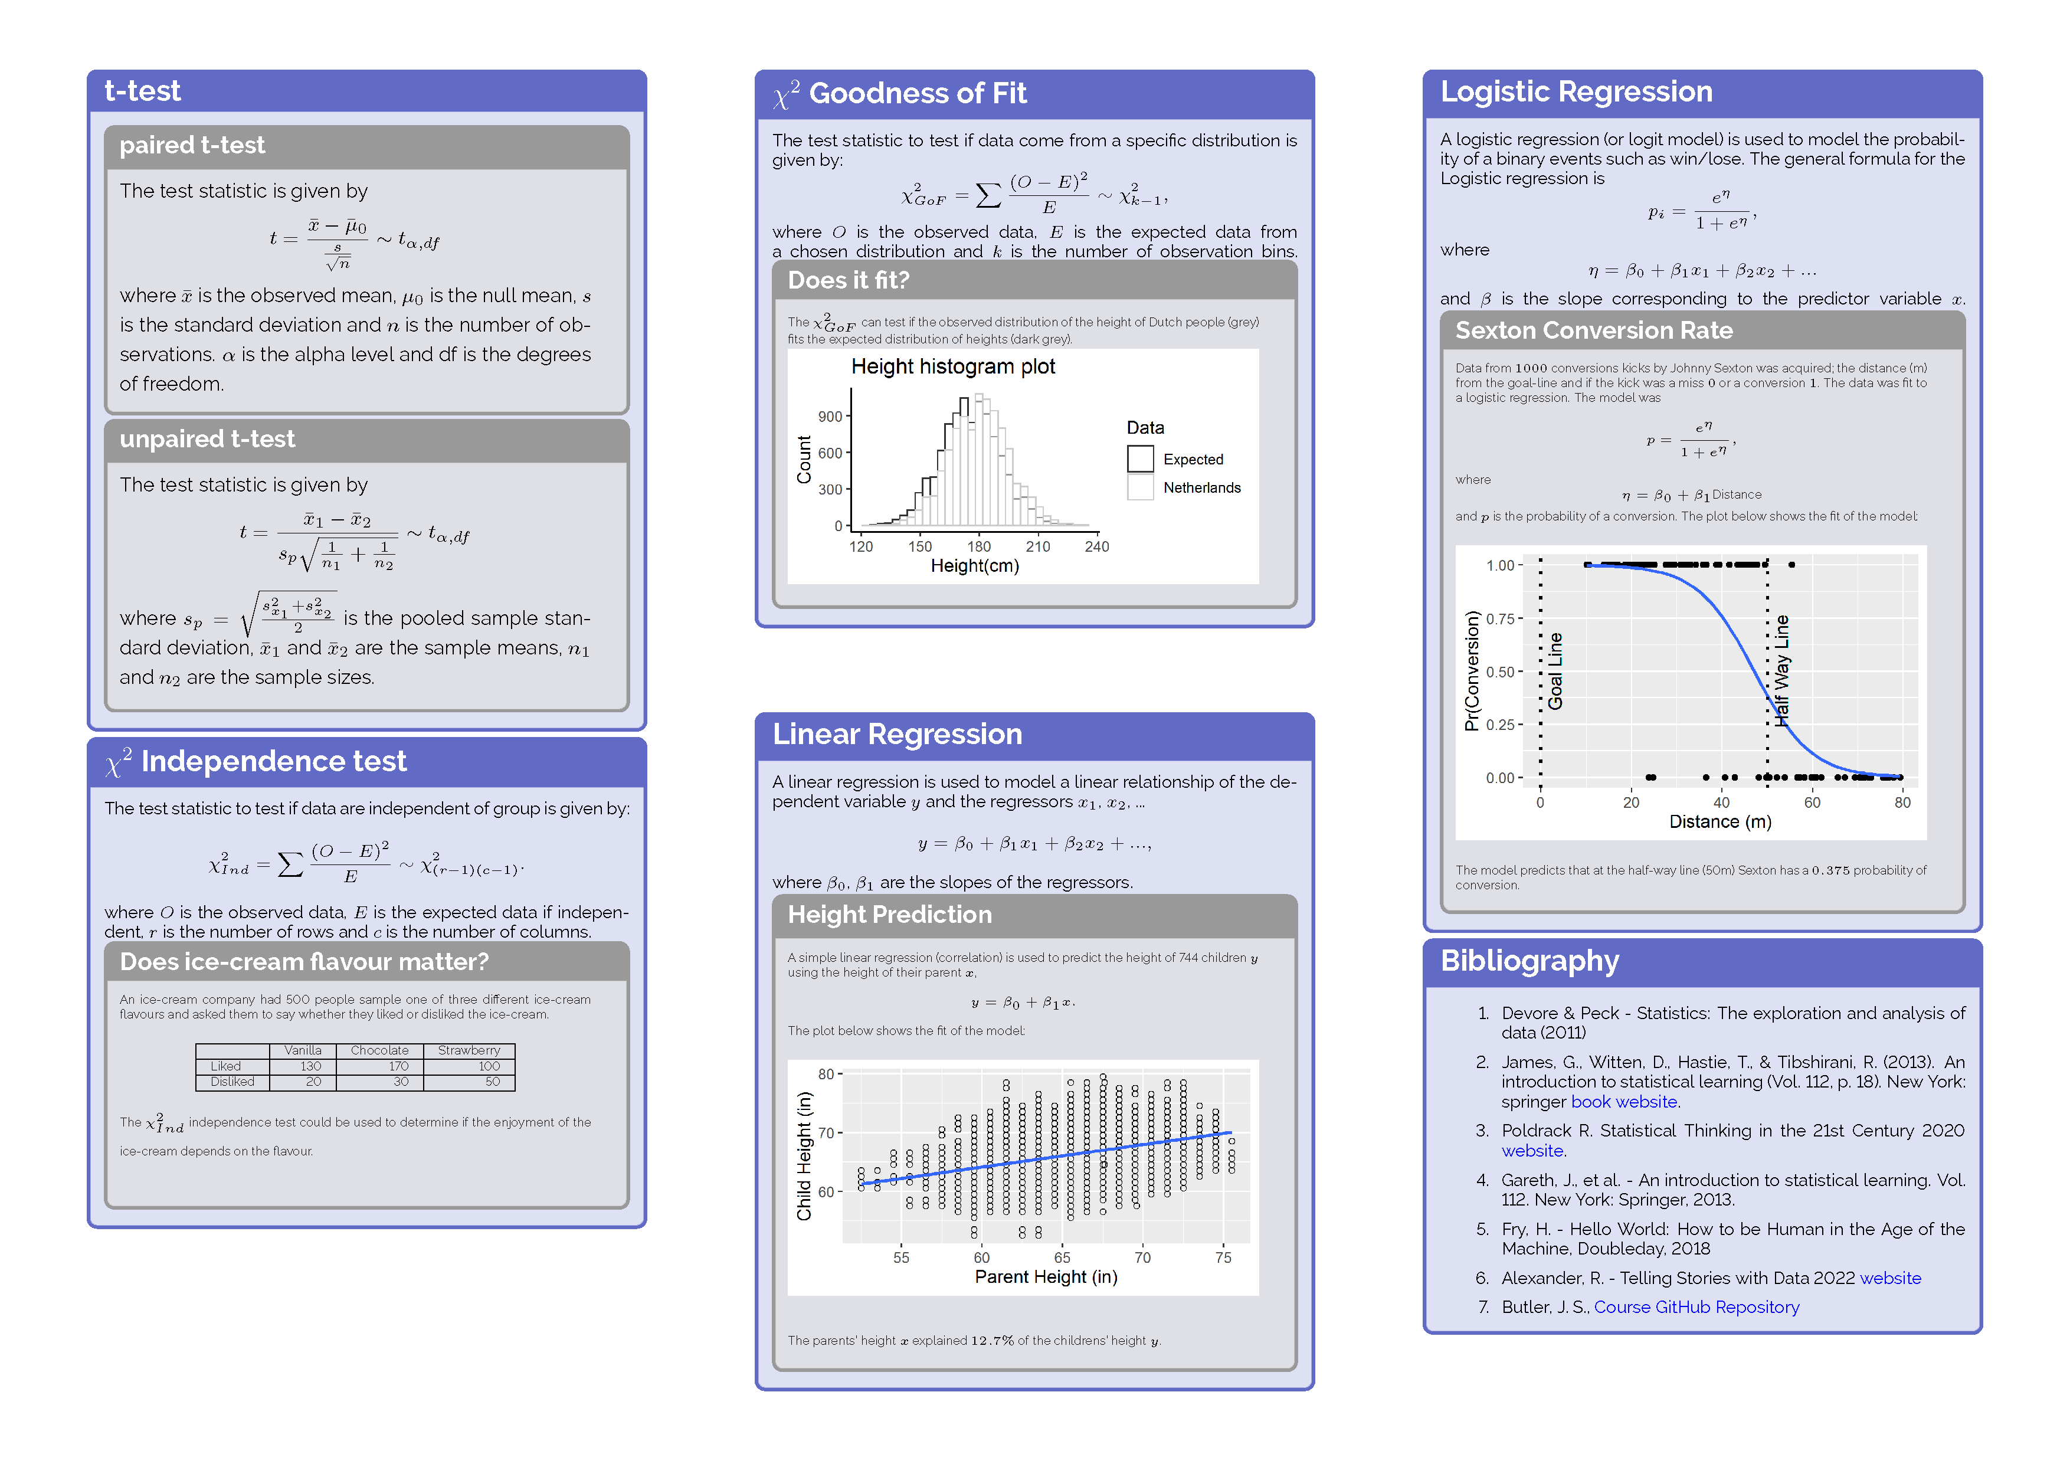
Week 6-7

Slide 38
Week 7-8

Slide 39
Week 7-8

Slide 41
Week 9-10

Slide 42
Week 10-11

Slide 44
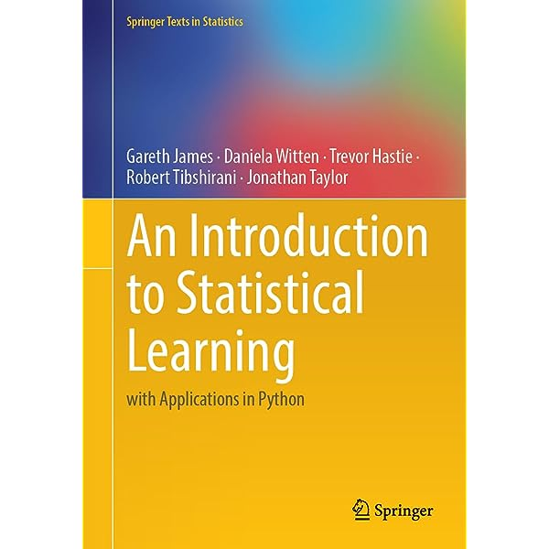
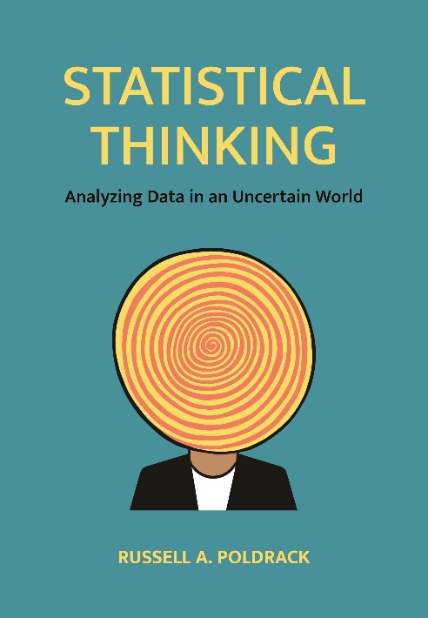
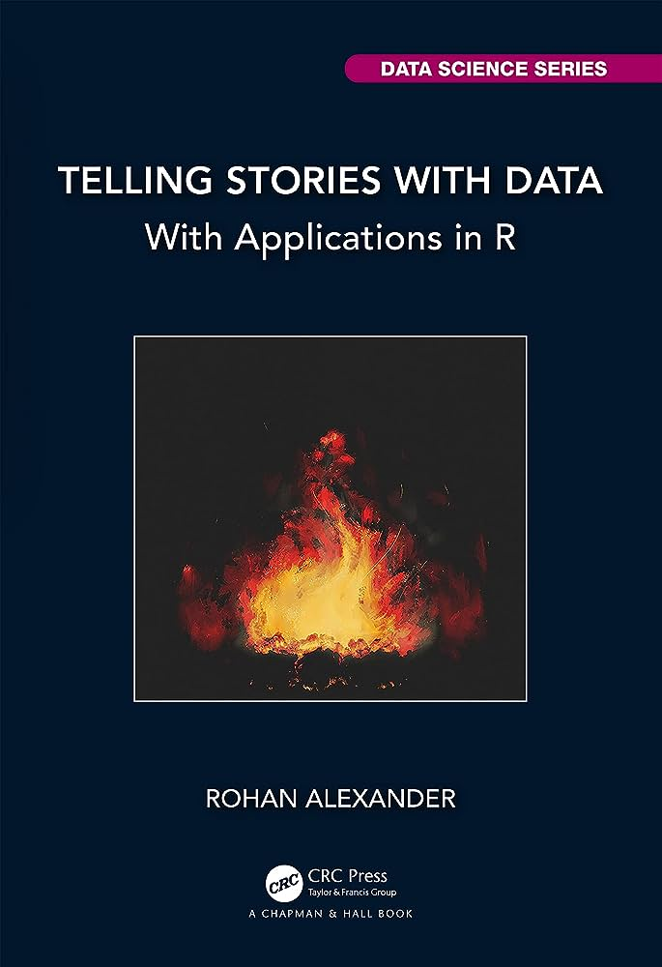
Bibliography

Slide 45
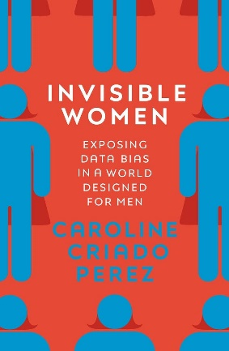

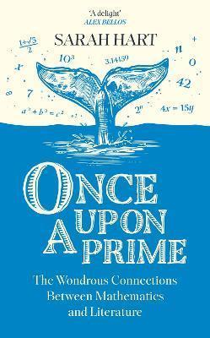
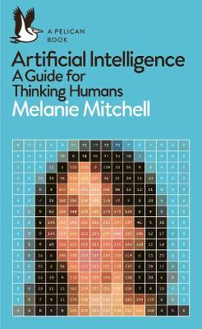

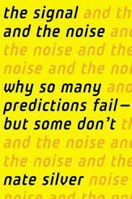
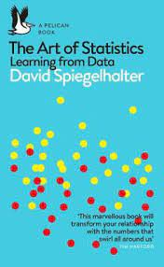
Popular Books
Criado Perez, C., (2021), Invisible Women: Data Bias in a World Designed for Me
Fry, H. (2018), Hello World: How to be Human in the Age of the Machine
Hart, S., (2023), Once Upon a Prime
Mitchell, M. (2019), Artificial Intelligence: A Guide for Thinking Humans
Rosling, H, Rosling, O, Rosling Ronnlund, (2019), Factfulness: Ten Reasons We're Wrong About The World - And Why Things Are Better Than You Think
Silver, N, (2013) The Signal and the Noise: The Art and Science of Prediction
Spiegelhalter, D. (2019), The art of statistics: Learning from data

Slide 46
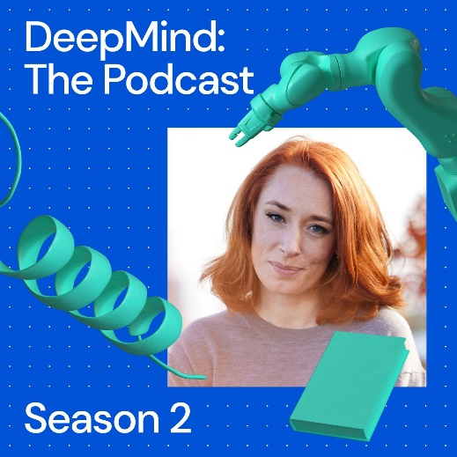
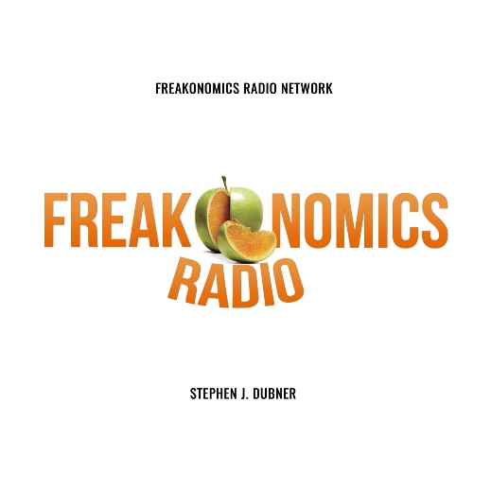
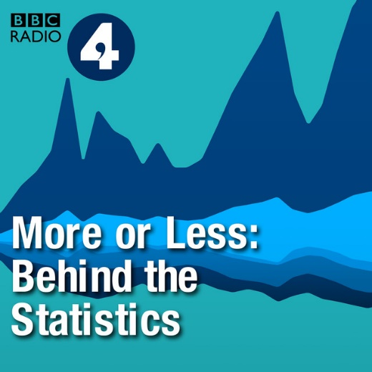


Podcasts
Deep Mind: Podcast
Freakonomics Podcast
More or Less: Behind the Stats
Visible Women
Colm O’Regan: The Function Room

Slide 47
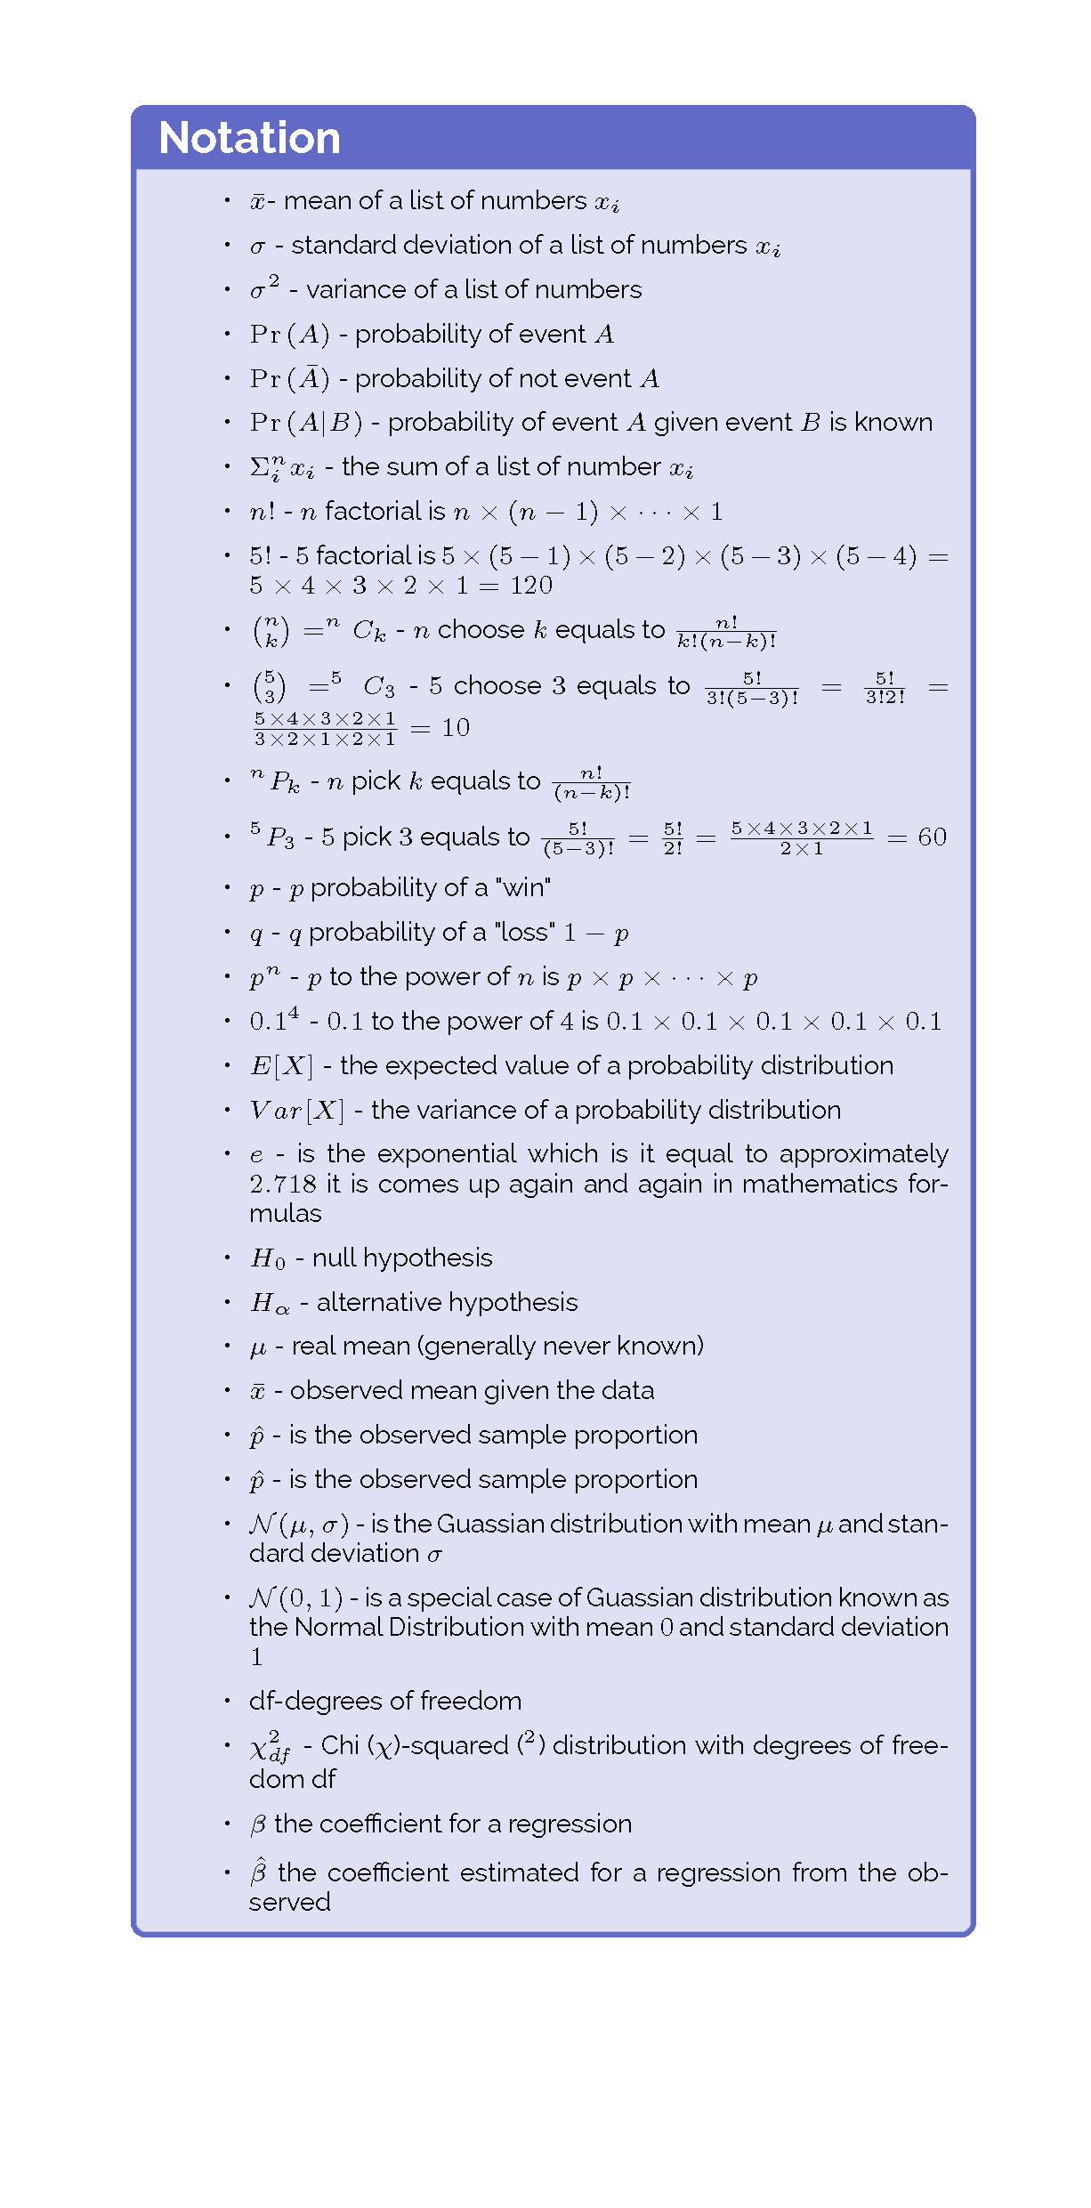

Slide 48
Preview

Slide 50
Measures of Locations

Slide 51
Measures of Locations
First moment
Mean (average)
Median
Mode
Second Moment (Spread)
Standard deviation
Variance
Third Moment
Skewness

Slide 52
First Moment of Data (Middle)

Slide 53
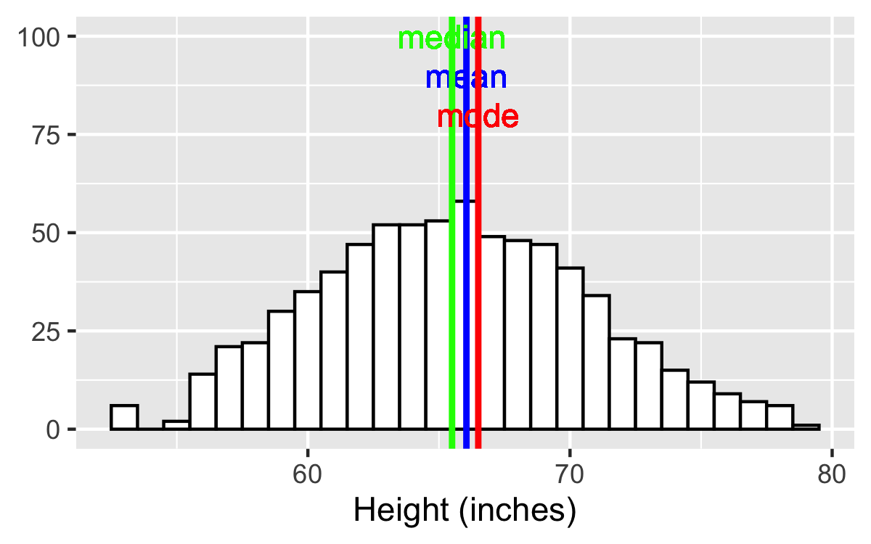
Measures of Locations
First moment
Mean (average)
Median
Mode

Slide 54
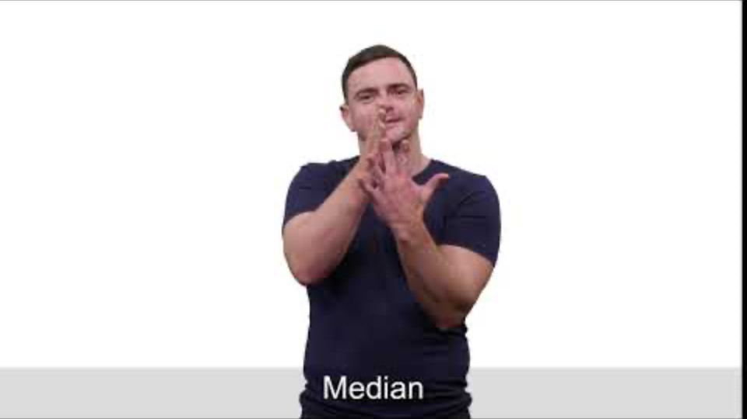
Median: Irish Sign Language
Irish Sign Language STEM Glossary https://www.dcu.ie/islstem/index.shtml

Slide 55
Second Moment
The spread of the data

Slide 56
Measures of Locations
Second Moment (Spread)
Standard deviation
Variance

Slide 57
Third Moment of Data (Skewness)

Slide 58
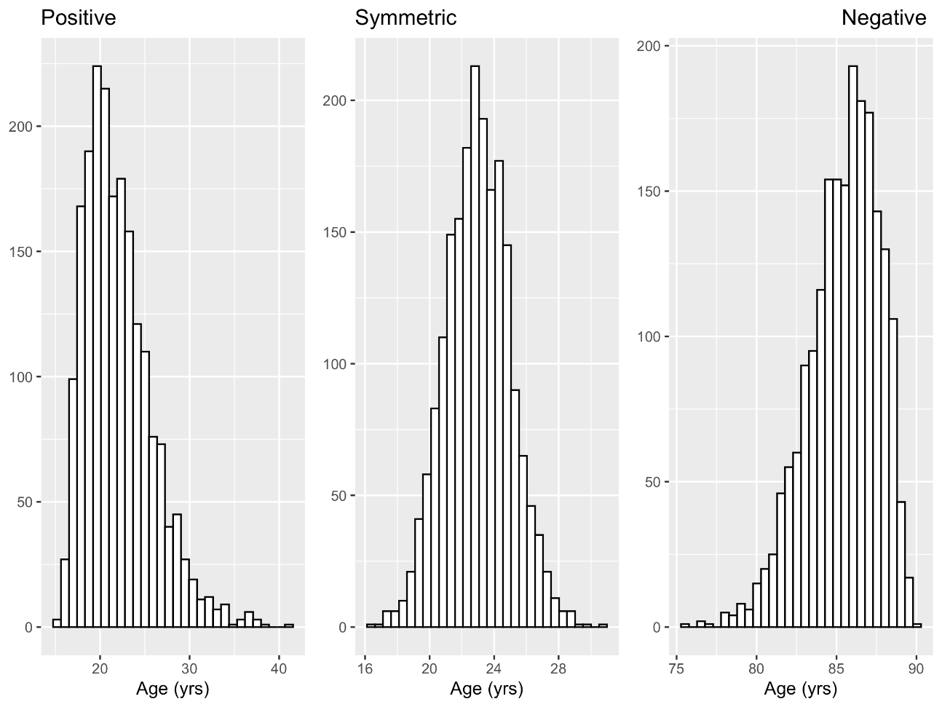
Measures of Locations
Third Moment
Skewness

Slide 59
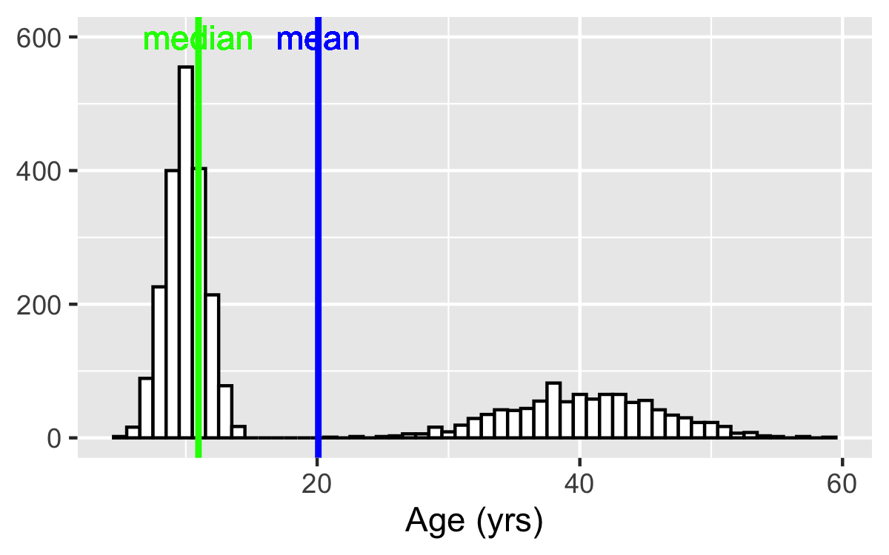
Problems with Moments of location
Ages at a wiggles Concert

Slide 60
Counting Rules
Dr. John S. Butler

Slide 61
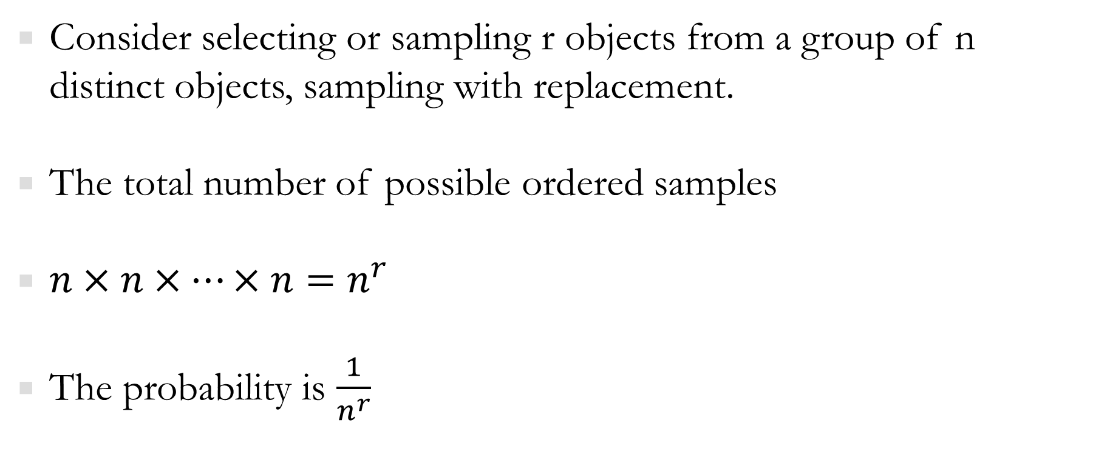
Useful counting Rules
Consider selecting or sampling r objects from a group of n distinct objects, sampling with replacement.
The total number of possible ordered samples
$n×n×…×n=n^{r}$
The probability is $\frac{1}{n^{r}}$

Slide 62
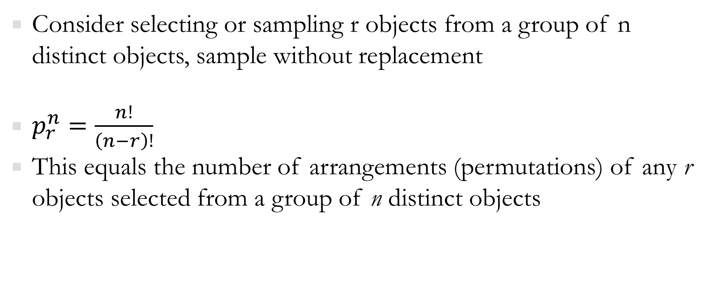
Useful counting Rules
Consider selecting or sampling r objects from a group of n distinct objects, sample without replacement
$p_{r}^{n}=\frac{n!}{\left(n−r\right)!}$
This equals the number of arrangements (permutations) of any r objects selected from a group of n distinct objects

Slide 63
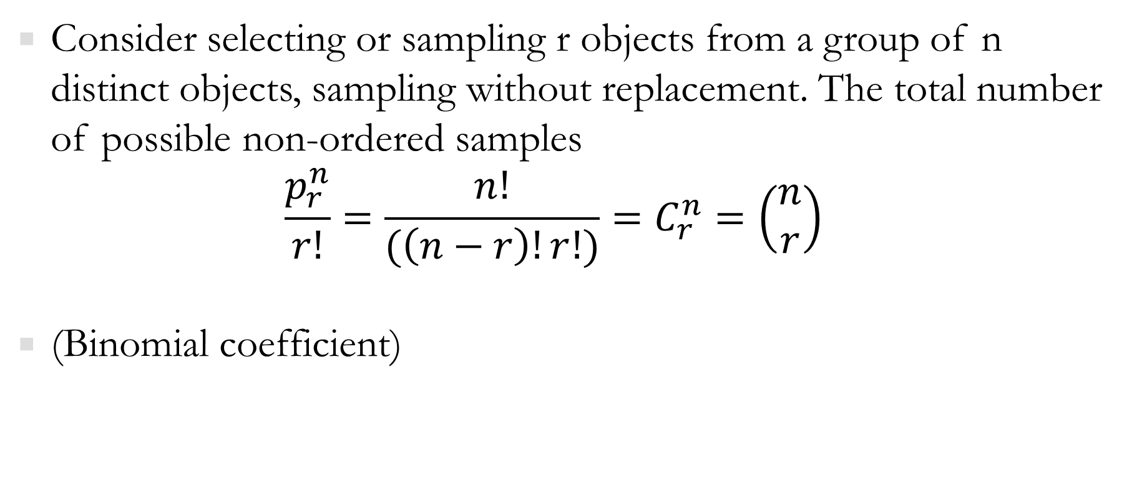
Useful counting Rules
Consider selecting or sampling r objects from a group of n distinct objects, sampling without replacement. The total number of possible non-ordered samples
$$\frac{p_{r}^{n}}{r!}=\frac{n!}{(\left(n−r\right)!r!)}=C_{r}^{n}=\left(\begin{matrix}n \\ r\end{matrix}\right)$$
(Binomial coefficient)

Slide 64
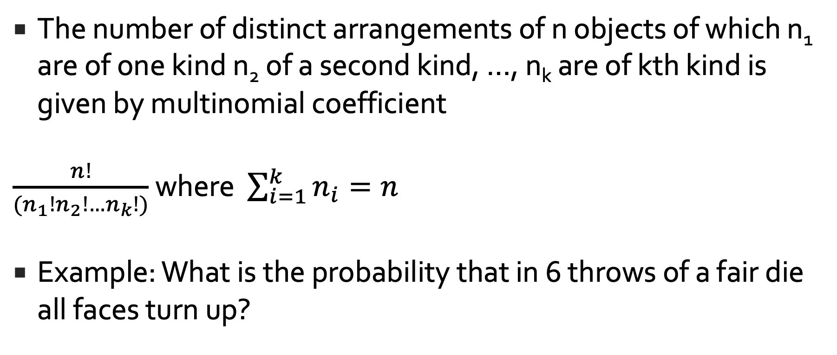
Useful counting Rules
The number of distinct arrangements of n objects of which n₁ are of one kind n₂ of a second kind, …, n_{k} are of kth kind is given by multinomial coefficient
$\frac{n!}{(n_{1}!n_{2}!…n_{k}!)}$ where $\sum_{i=1}^{k}{n_{i}=n}$
Example: What is the probability that in 6 throws of a fair die all faces turn up?

